Slide 1

Teachable Machine
Group Exercise

Slide 2

Teachable machine
https://teachablemachine.withgoogle.com/

Slide 3
Objective
Train your own neural network with something that has a real-world application (however modest). You must choose a type of project
Image recognition Sound recognition Pose recognition

Slide 4
Objective
You must (successfully) train a neural network and present your work to the rest of the class. This is a group activity (you all have a group assigned to the group project, so we will use those same groups) One person from each group must upload the project through Canvas

Slide 5
methodology
You have to choose a real application in which you will use teachable machine.
Then you will have to train the algorithm and test it with inputs that I have not seen until now (as I have done in class) and improve it if necessary.
On the day we determine, we will dedicate the class to groups presenting their models and explaining how they can fit into an application in the real world, including a demonstration of how they work live (remember to upload the link of the model to Canvas before class!).

Slide 6
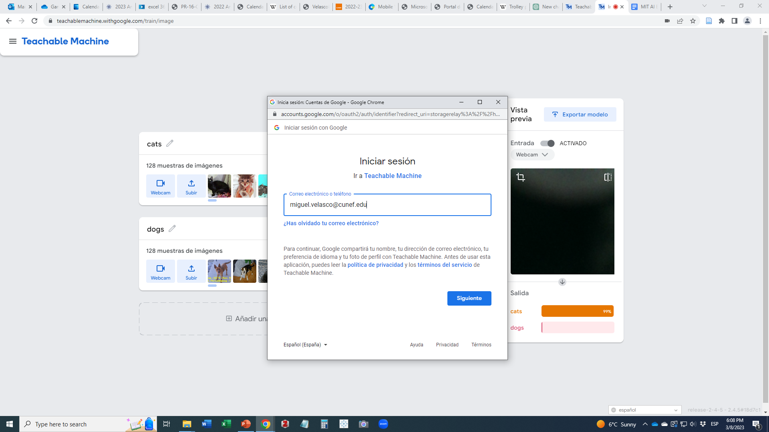

Slide 7
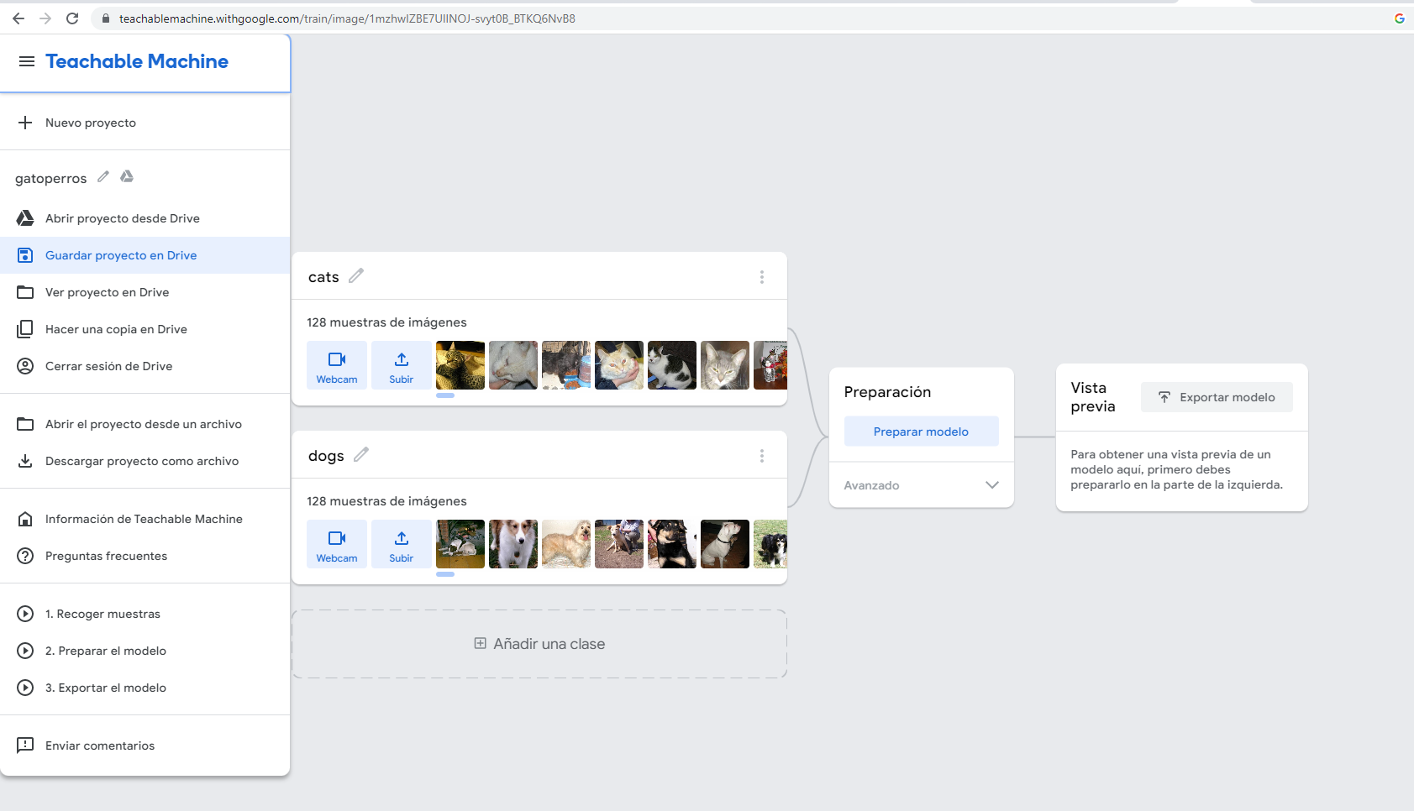

Slide 8
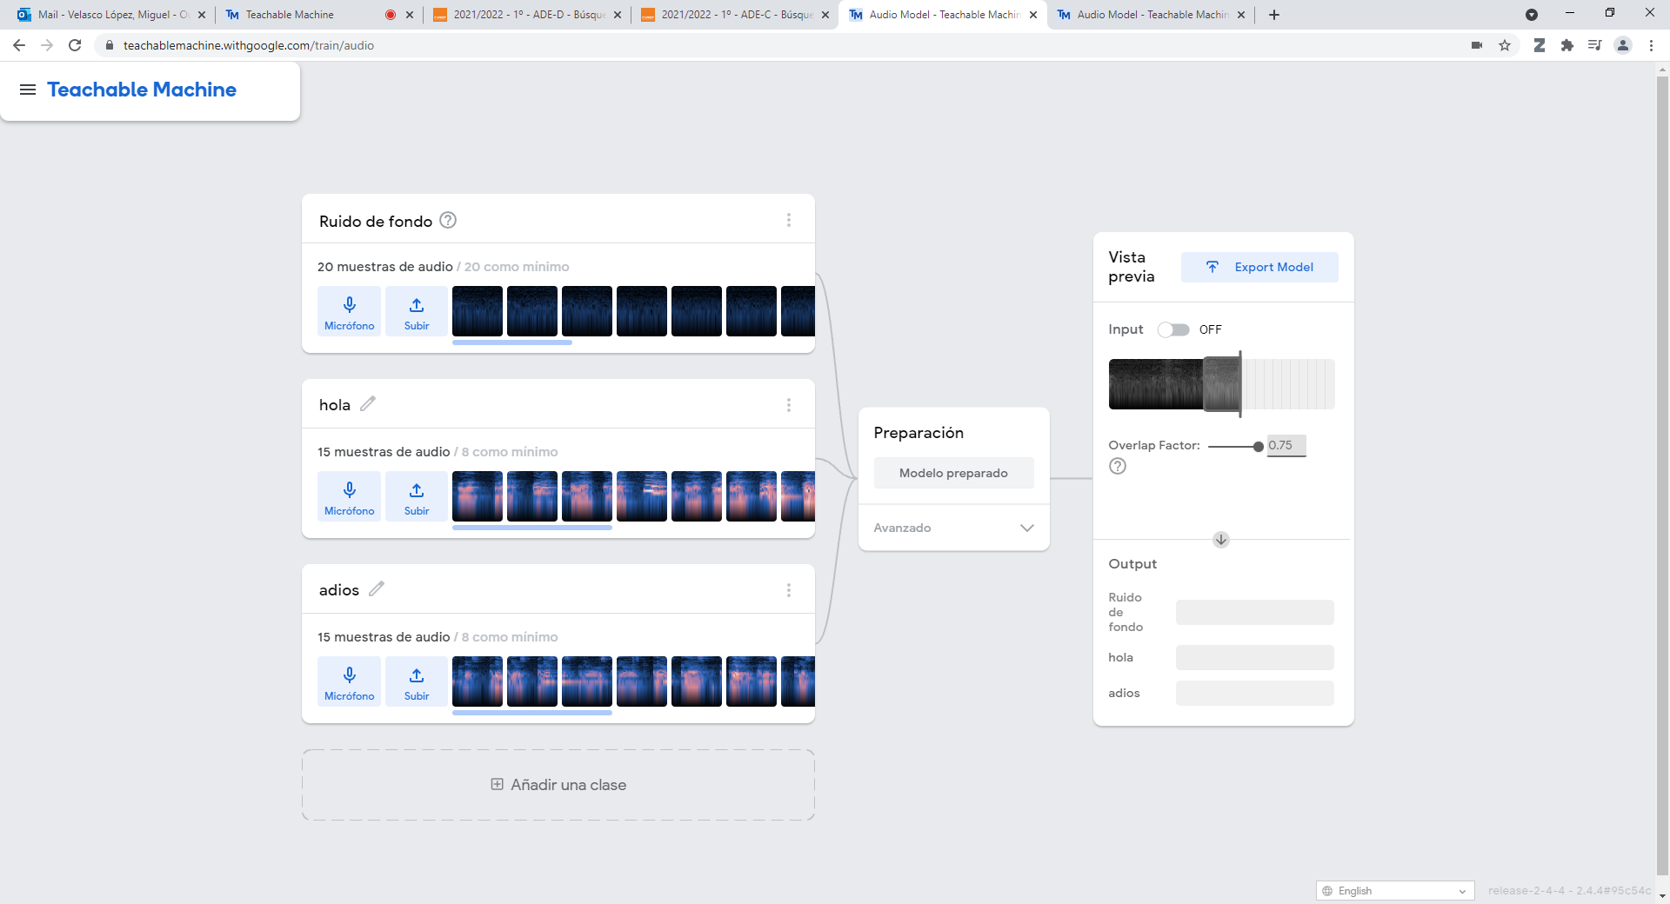
To export

Slide 9
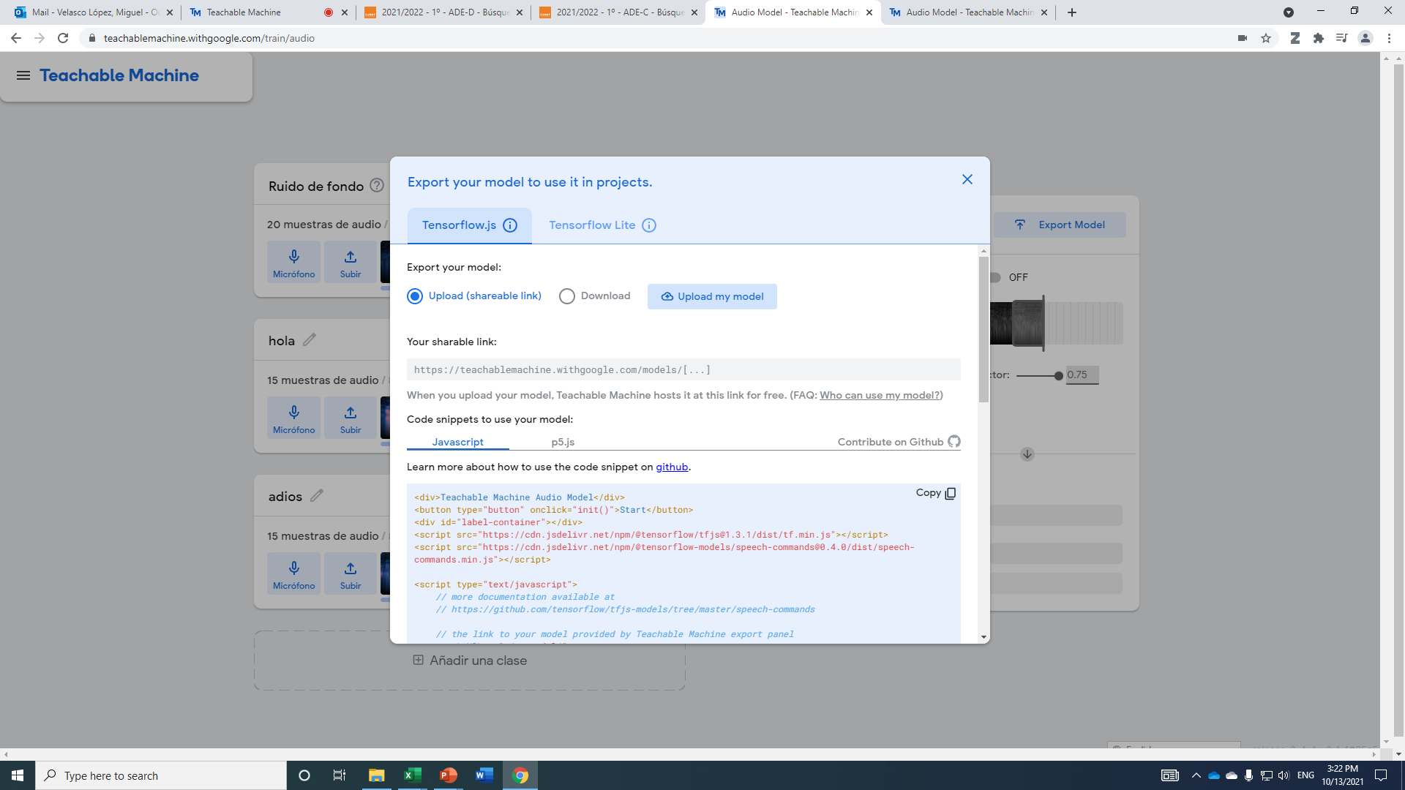
Click here to generate the link to the file containing the project

Slide 10
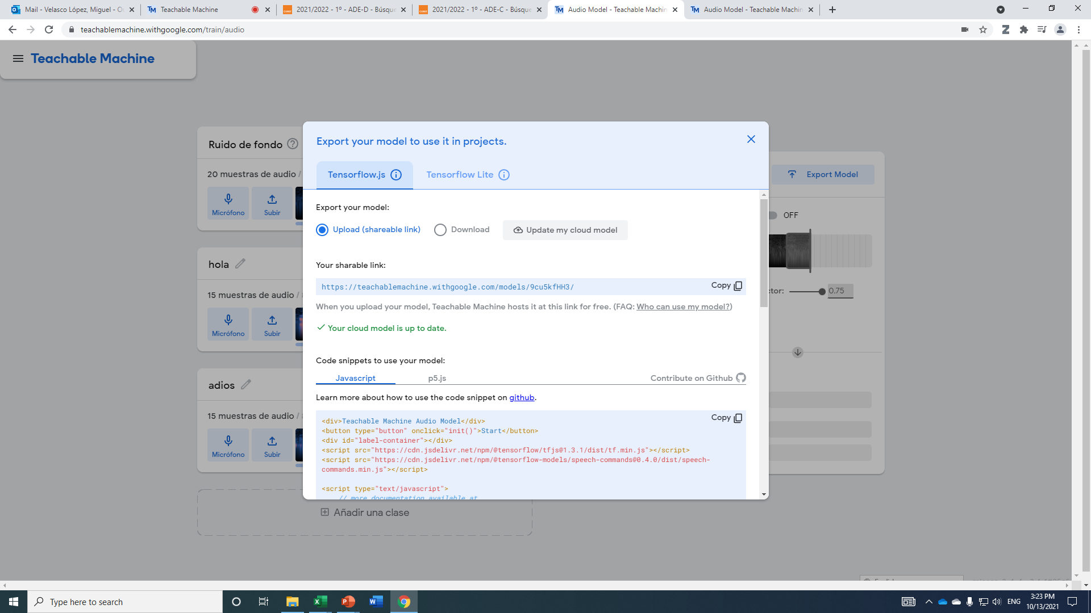
This is the URL of your trained model, which you will send through Canvas

Slide 11
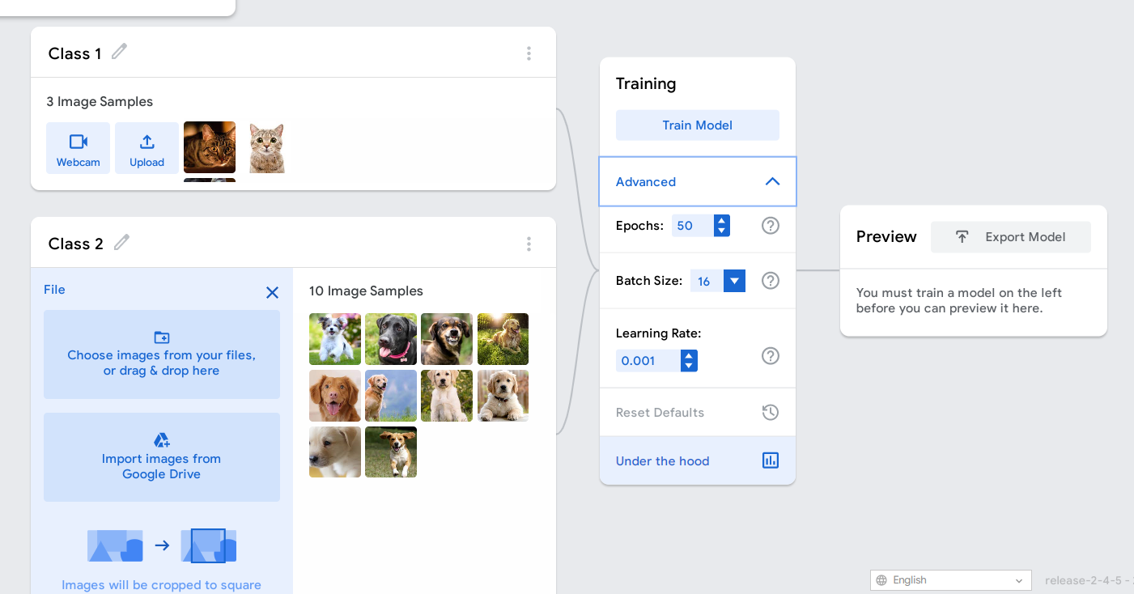
You will also have to upload the confusion matrix

Slide 12
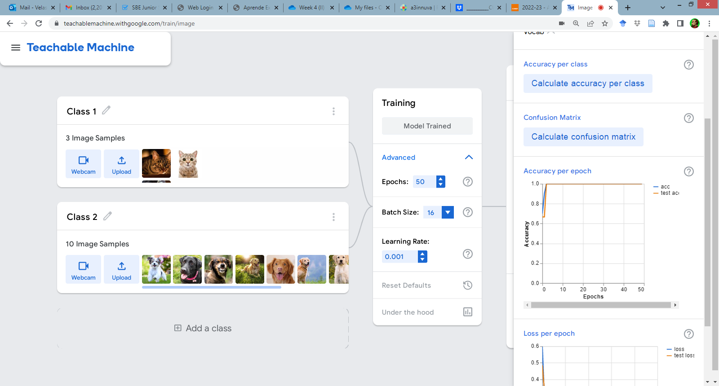

Slide 13
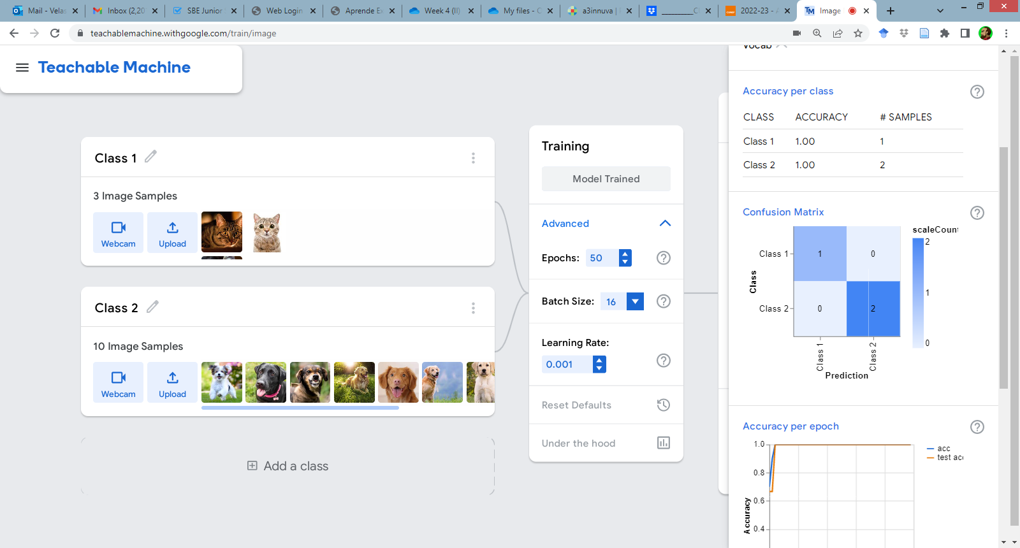
You have to upload a screenshot of the matrix

Slide 14
You have to upload a screenshot of the matrix

Slide 15
Real-world application
Considering what can be done, think of a real-world application. Do not just focus on the classification, think what you would do with the results of the network if you could connect the result to another System, which would take as a starting point the result of the neural network.
It doesn't have to be a complicated application! Think about some of the examples we've talked about in class.

Slide 16
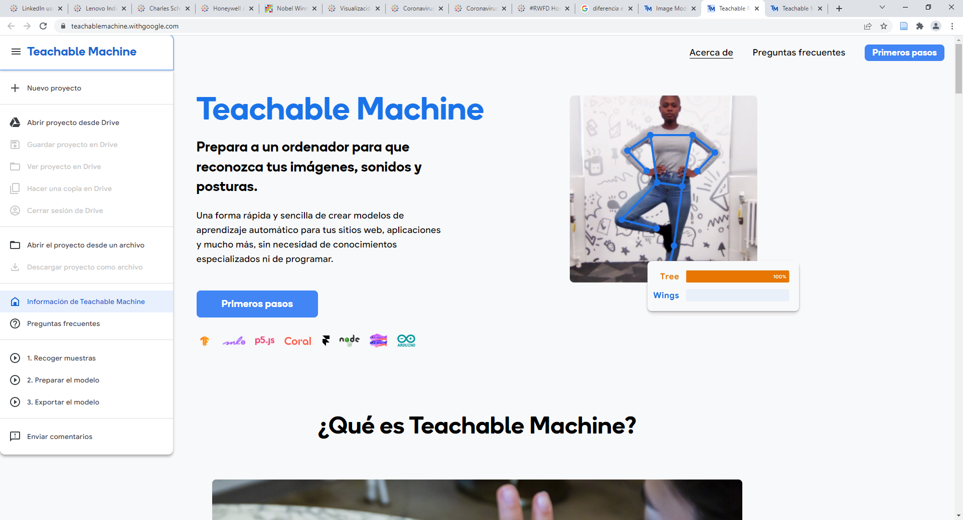
Tutorials and Recommended Reading
Tutorials and Recommended Reading

Slide 17
OTHER Videos and reference materials
1. https://www.youtube.com/playlist?list=PLJfHZtseuscuTQfodmFnbZ3rBgCWsRT9t These are very short videos from Google explaining how to collect data and train Teachable Machine 2. Videos showing Teachable Machine in Action and how to use the models as part of other projects (this last part is sadly too advanced for you now, but as soon as you learn to code you can do similar things! The presenter is a very enthusiastic person, and the videos are in English): Part 1: Imágenes https://www.youtube.com/watch?v=kwcillcWOg0
Part 2: Poses https://www.youtube.com/watch?v=UPgxnGC8oBU
Part 3: Sonidos https://www.youtube.com/watch?v=TOrVsLklltM

